Slide 1
Logement Dans Sénégal
Par: Julia Nojeim

Slide 2
Faits Généraux
75% of Senegalese homes are self-built
There are very few requirements a home in Senegal needs to meet in order to be lived in

Slide 3
Les Types Différents de logement:
Il y a trois types de logement dans Sénégal.
Les types sont dans les régions différentes du pays.

Slide 4
Dans les Régions Rurales
“…between 1954 and 2003, low-income, informal residences took over 95 percent of natural areas…”¹
Ils sont huttes de boue ou de paille
Les toits sont de la paille ou de fer
Ils sont très petits
La cuisine et la salle de bain sont séparés de la maison
Ils n'ont pas d'électricité ou d'équipements modernes
¹ www.housingfinanceafrica.org/country/senegal

Slide 5
They are arranged into villages called ‘Wolof villages’
Families live in enclosed compounds called ‘Ker’
The man of the village lives in a hut near the entrance of the village; his wives’ houses surround it
These ‘Ker’ are centered around a village center called ‘Pencha’

Slide 7
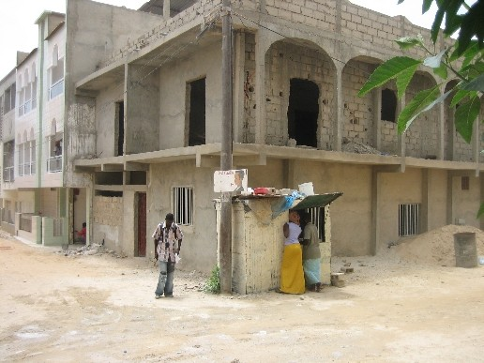
Dans les Régions Plus Prospères
Les murs sont de ciment, de béton, ou de la brique
Les toits sont de fer
Beaucoup des familles sont dans une maison

Slide 8
La vie dans la ville pour les riches
Rapid industrialization is leading to urbanization which the small cities are not prepared to handle
Modern apartments and homes with electricity and modern amenities
Surrounding these modern homes in a city are ‘shantytowns’, or lowest-class huts much like that in a rural area; but sometimes even in worse conditions
Many multi-floor homes because land costs a lot

Slide 9
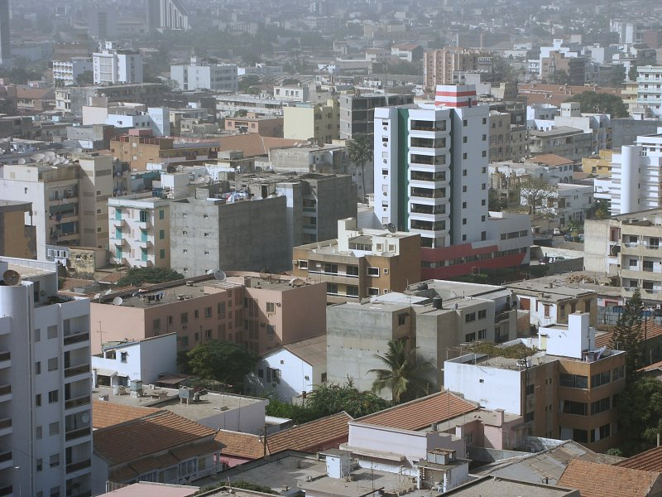
La centre-ville de Dakar

Slide 10
Les changements logement
The Senegalese government is making two new laws to help improve housing situations

Slide 11
The “one family one roof” initiative:
Makes housing more affordable so many people do not have to live in the same cramped house
Mostly in cities

Slide 12
Land Tenure Act:
Temporary living permits are turned into, at no cost, permanent living permits so people invest in their homes and living conditions will improve
Also mostly in cities

